Slide 1
Climate Forcing and Uncertainty
Major factors influencing climate change
What makes climate prediction so hard?

Slide 2
Climate Forcing and Uncertainty
Changes in the Earth’s Energy Balance
Change the incoming solar radiation
Change the fraction of solar radiation that is reflected
Change the longwave (heat) radiated from Earth back towards space

Slide 3
Climate Forcing and Uncertainty
Climate Forcings
Radiative Forcing:
The change in balance between solar radiation entering the atmosphere and the Earth’s radiation going out of the atmosphere.

Slide 4
Climate Forcing and Uncertainty
Climate Forcings
Radiative Forcing:
Positive Forcing:
tends to warm the earth
Negative Forcing:
tends to cool the earth

Slide 5
Climate Forcing and Uncertainty
Climate Forcings
Manmade Forcings:
Particle pollution
Rising Concentration of Greenhouse Gases
Deforestation

Slide 6
Climate Forcing and Uncertainty
Climate Forcings
Natural Forcings:
Changes in Sun’s brightness
Large volcanic eruptions

Slide 7
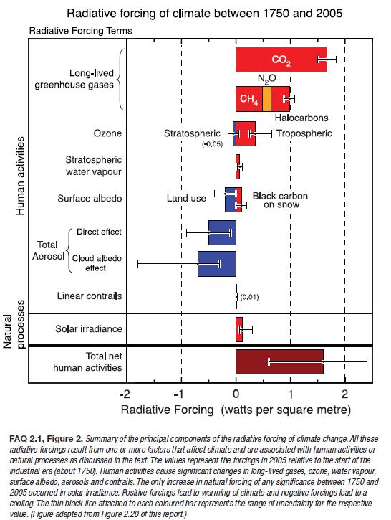

Slide 8
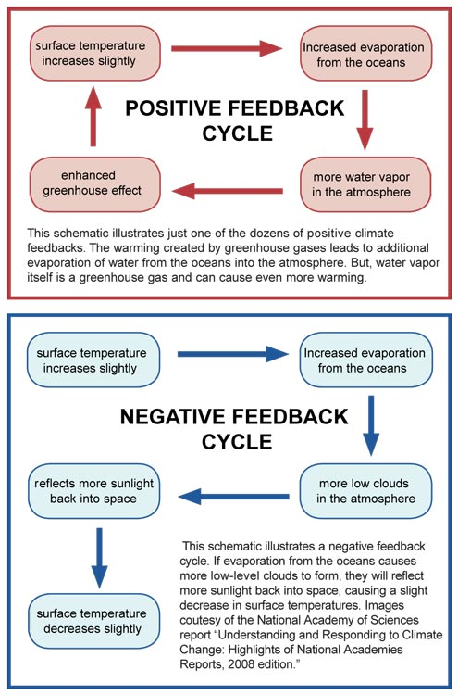

Slide 9
Climate Forcing and Uncertainty
What makes
climate prediction
so hard?

