Slide 1
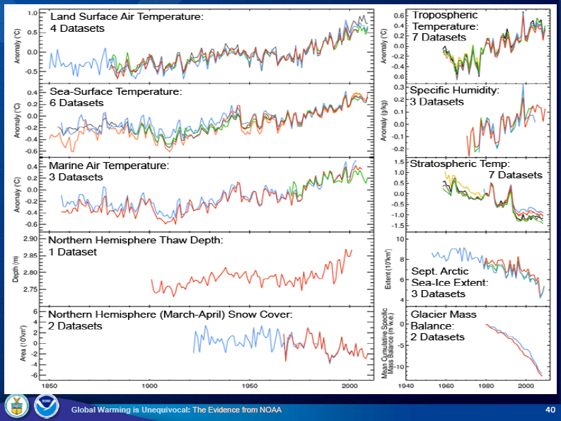
Evidence of Change Data

Slide 2
Global Temperature and Carbon Dioxide
Mitchell T. D. and P. D. Jones. 2005. An improved method of constructing a database of monthly climate observations and associated high-resolution grids. International Journal of Climatology 25,693-712. http://cru.csi.cgiar.org/PDF/mitchelljones.pdf

Slide 3
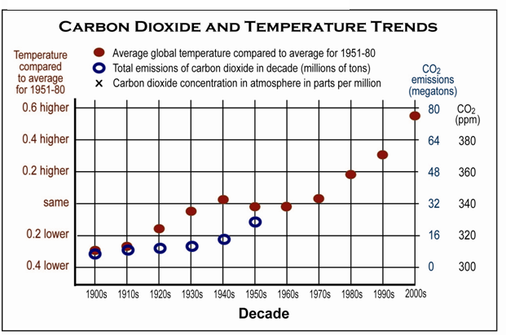
Graphing Temperature and Carbon Dioxide
In the 20th century

Slide 4
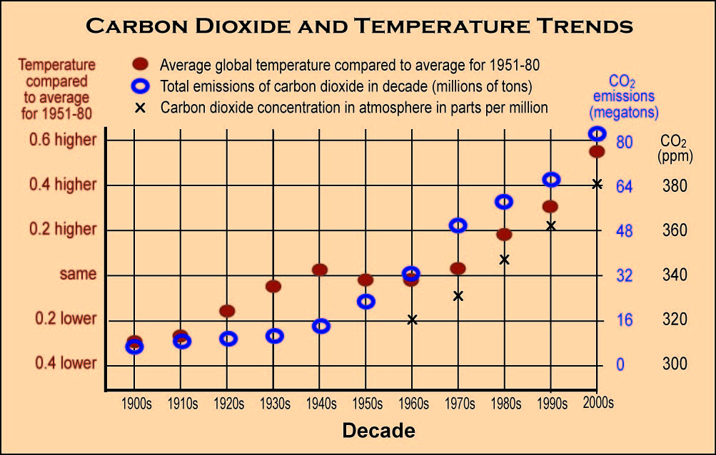
Graphing Temperature and Carbon Dioxide
In the 20th century

Slide 5
Graphing Temperature and Carbon Dioxide
over the last 450,000 years

