Slide 1
Climate
Change
Indicators
Impacts

Slide 2
Looking at the Indicators
of Climate Change
Environmental Conditions:
Describing Trends
and Hypotheses

Slide 3
For each of these indicators of Climate Change
describe the trend shown on the graph
identify a specific cause for the trend shown

Slide 4
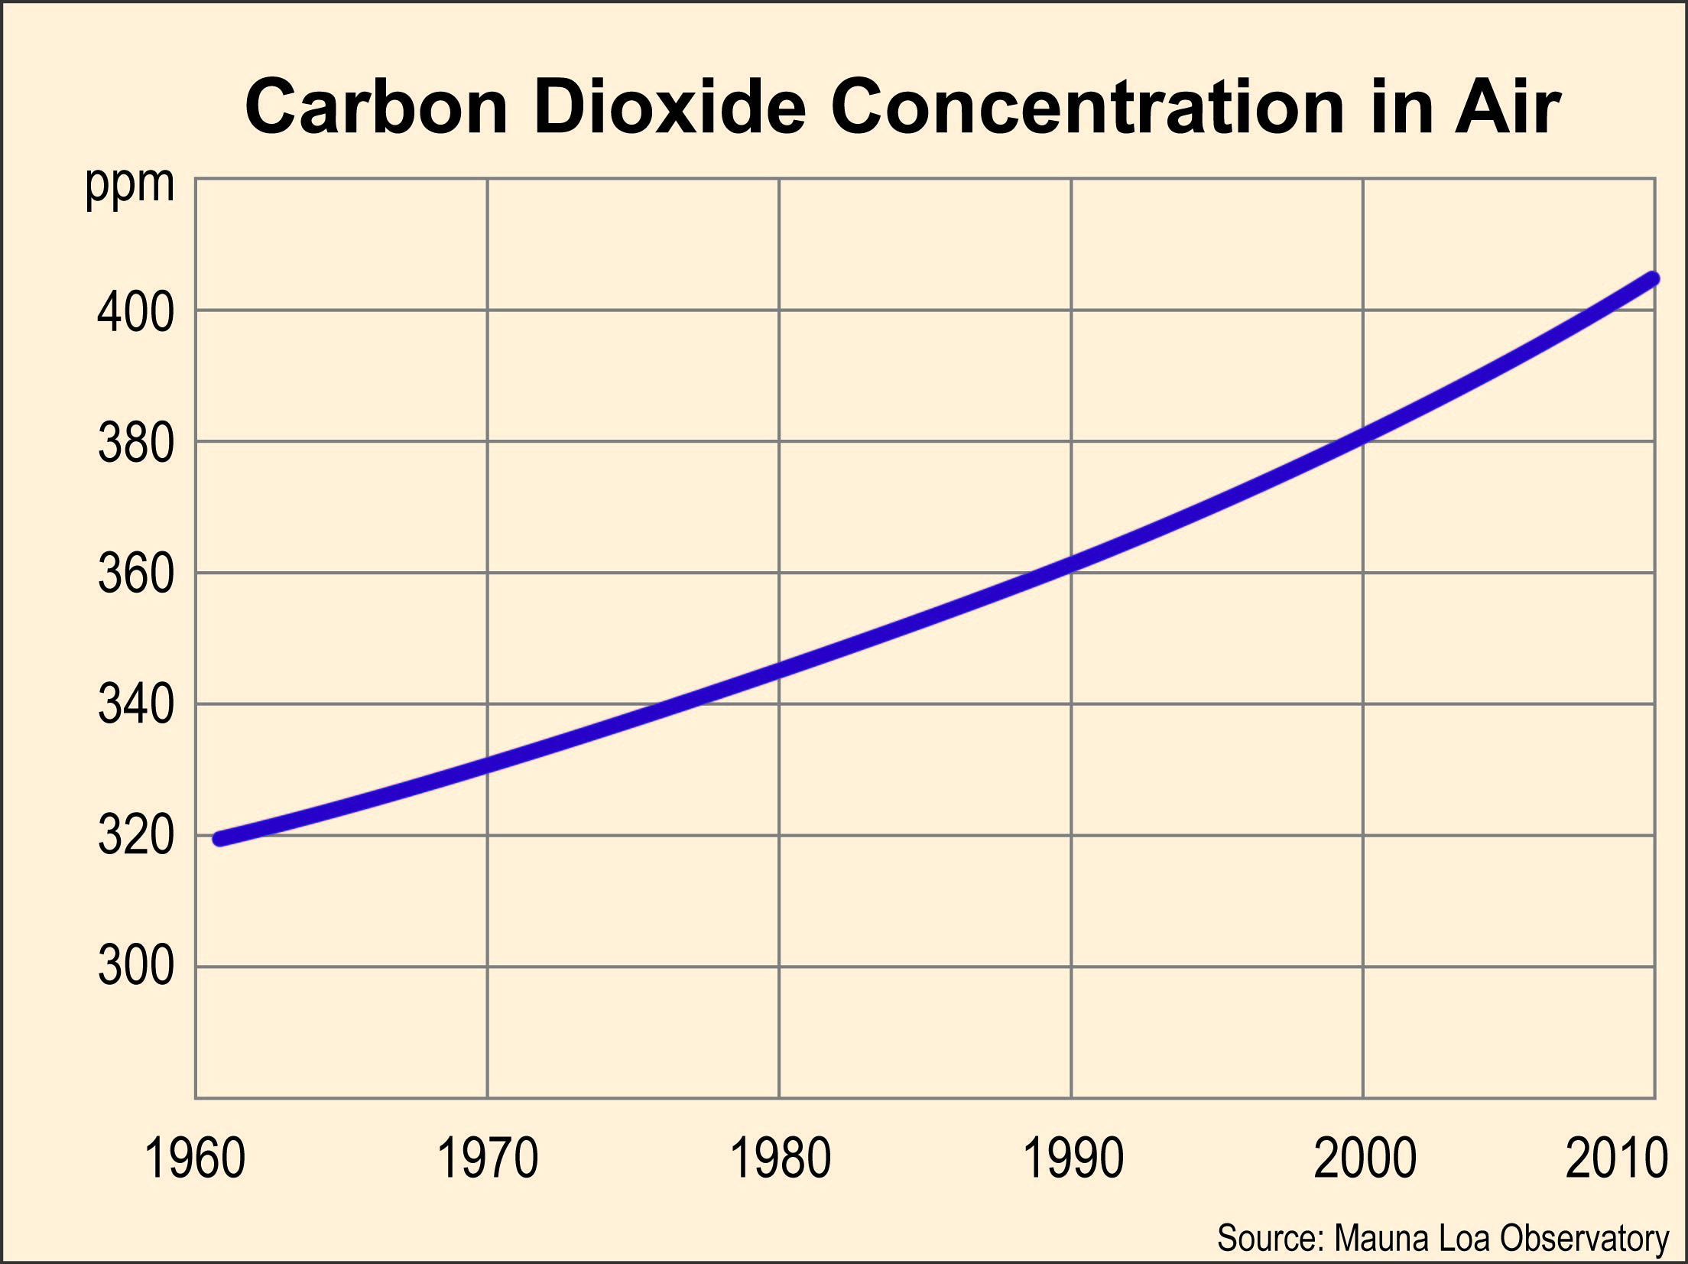
Trend: Every year the air has more CO₂ in it. It keeps increasing faster (it went up only 10 ppm in the 1960’s but more than 20 ppm between 2000 and 2010).

Slide 5
Cause: People are burning more coal and oil, releasing more carbon dioxide into the air.

Slide 6
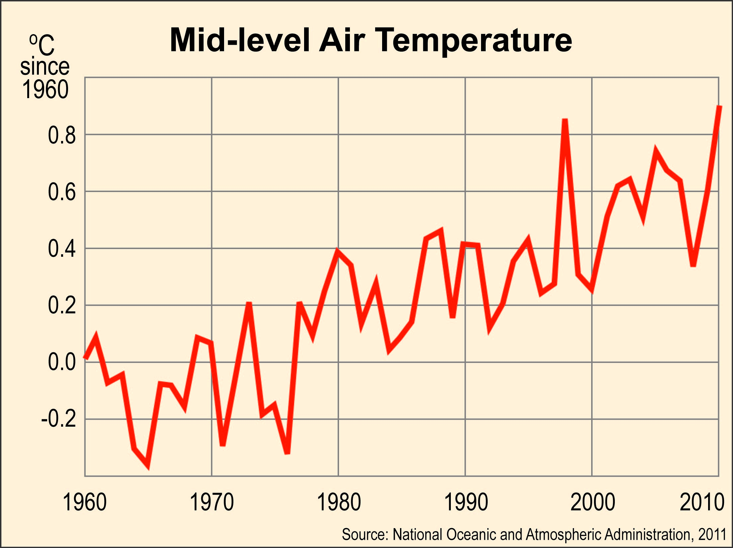
Trend: Very erratic, but the general trend is a higher temperature overall.

Slide 7
Cause: The higher concentration of carbon dioxide in the atmosphere has prevented outgoing radiation, causing the temperature to rise.

Slide 8
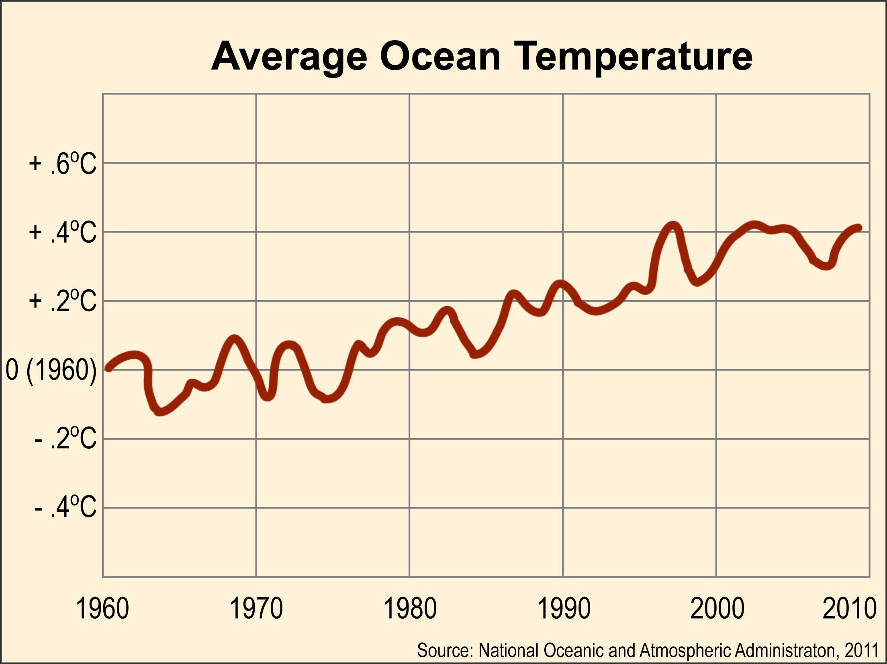

Slide 9
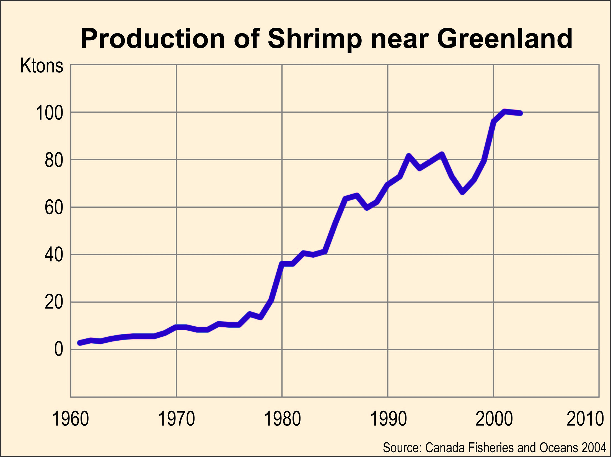

Slide 10
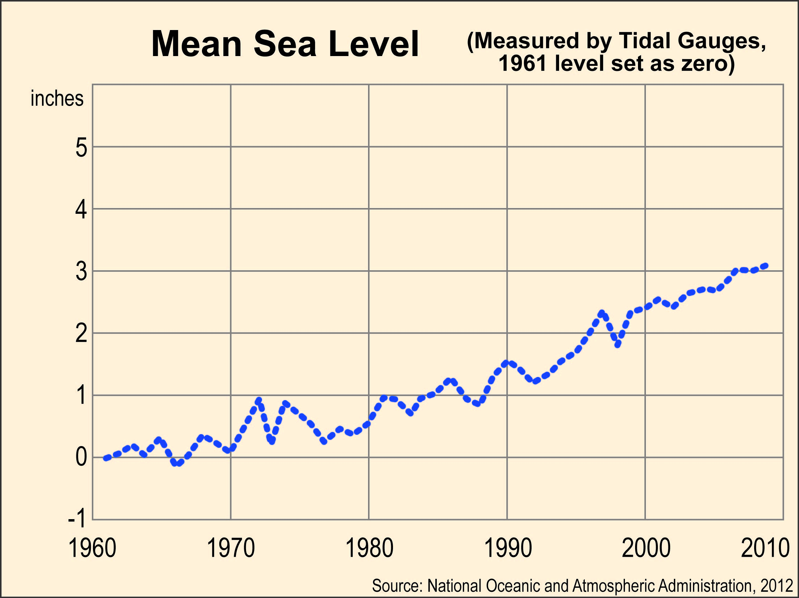

Slide 11
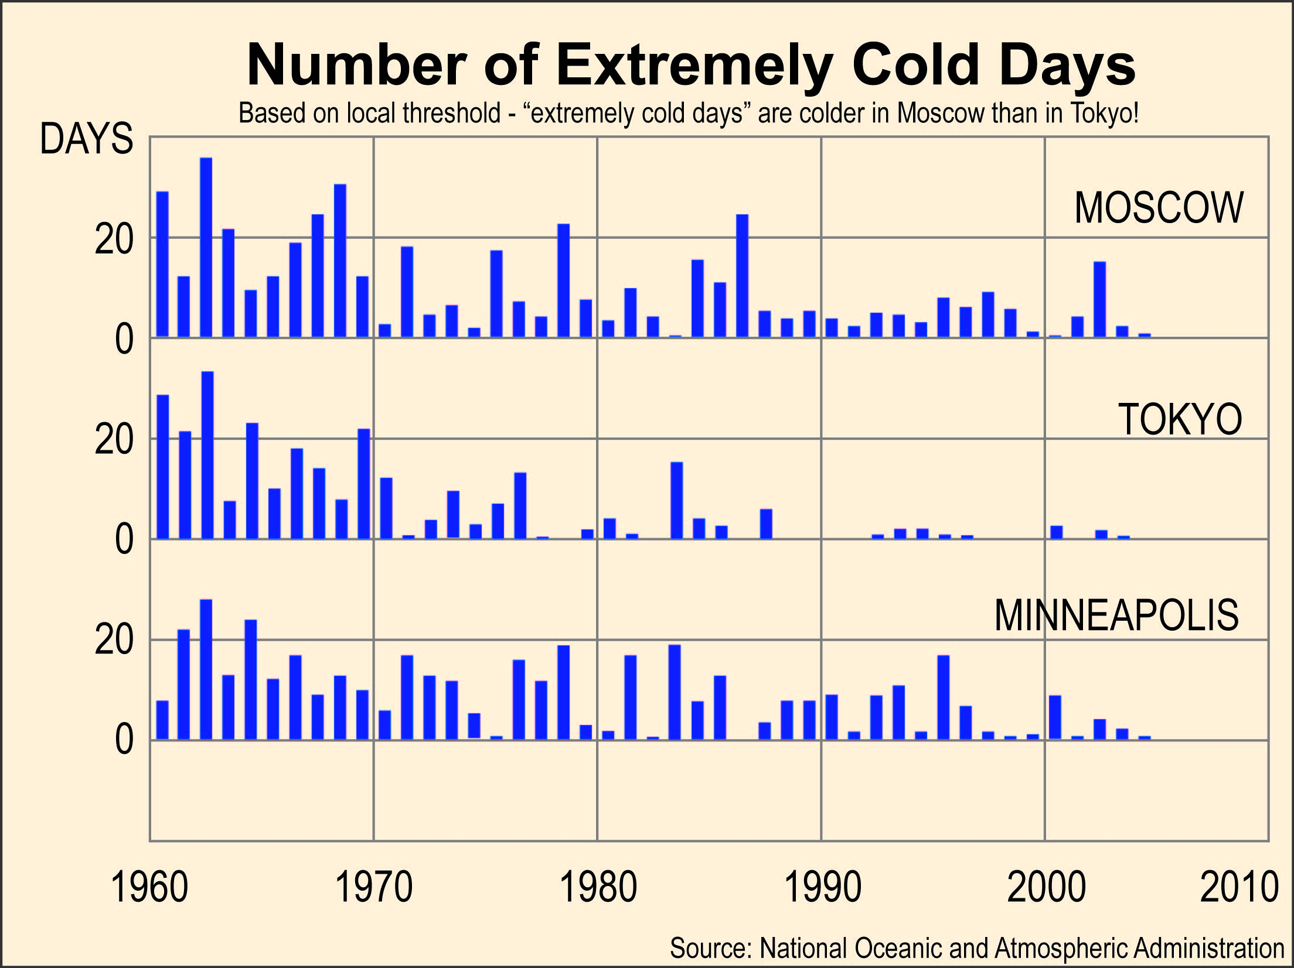

Slide 12
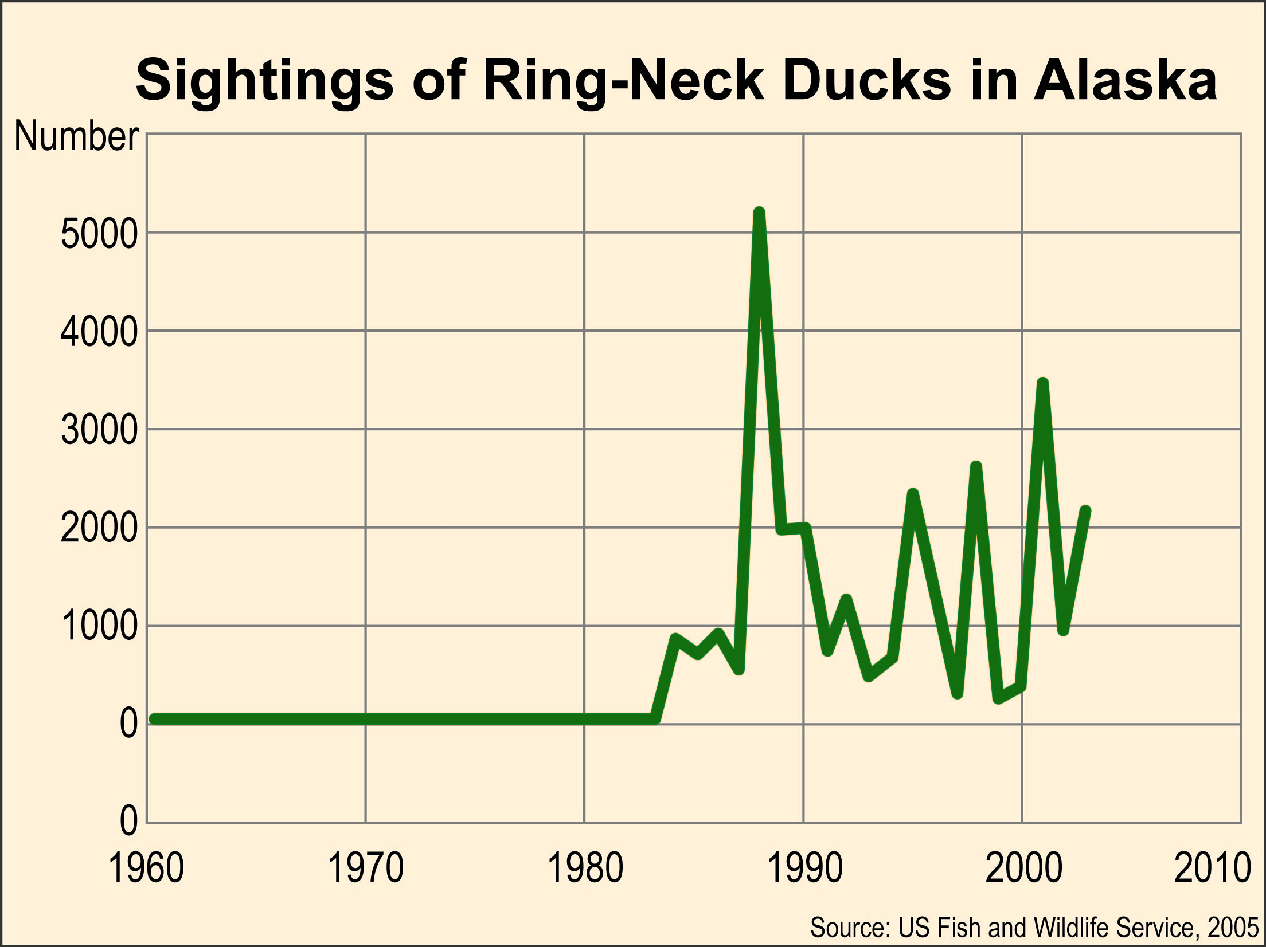

Slide 13
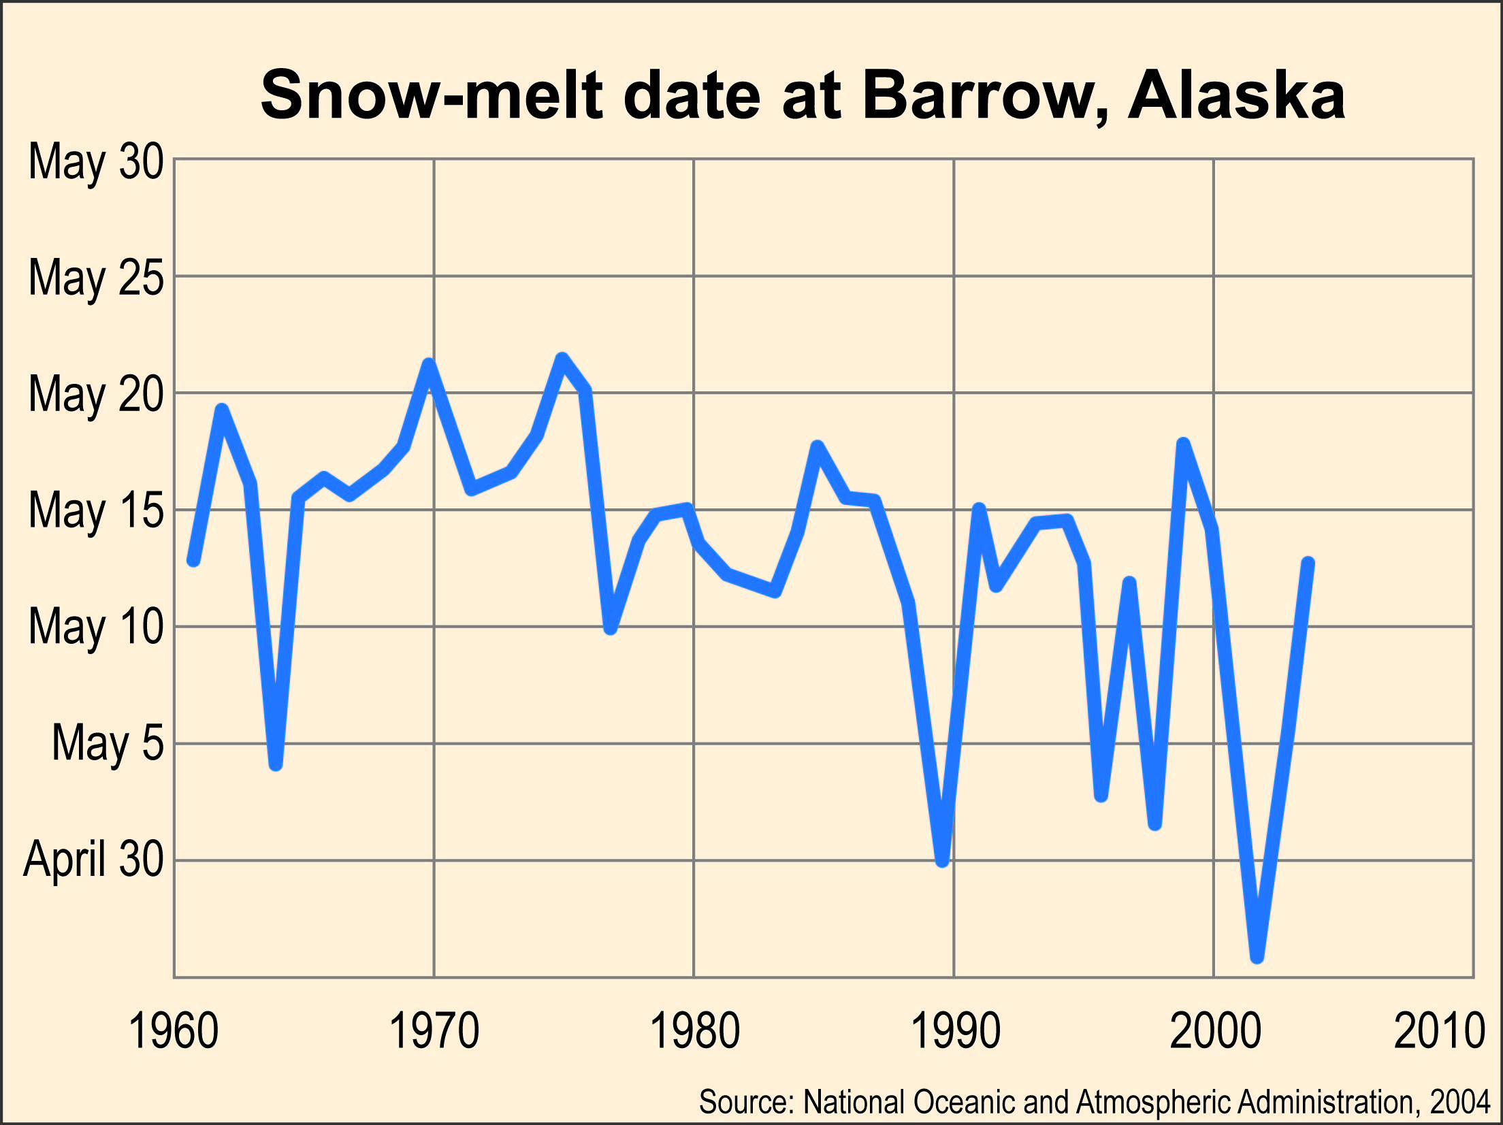

Slide 14
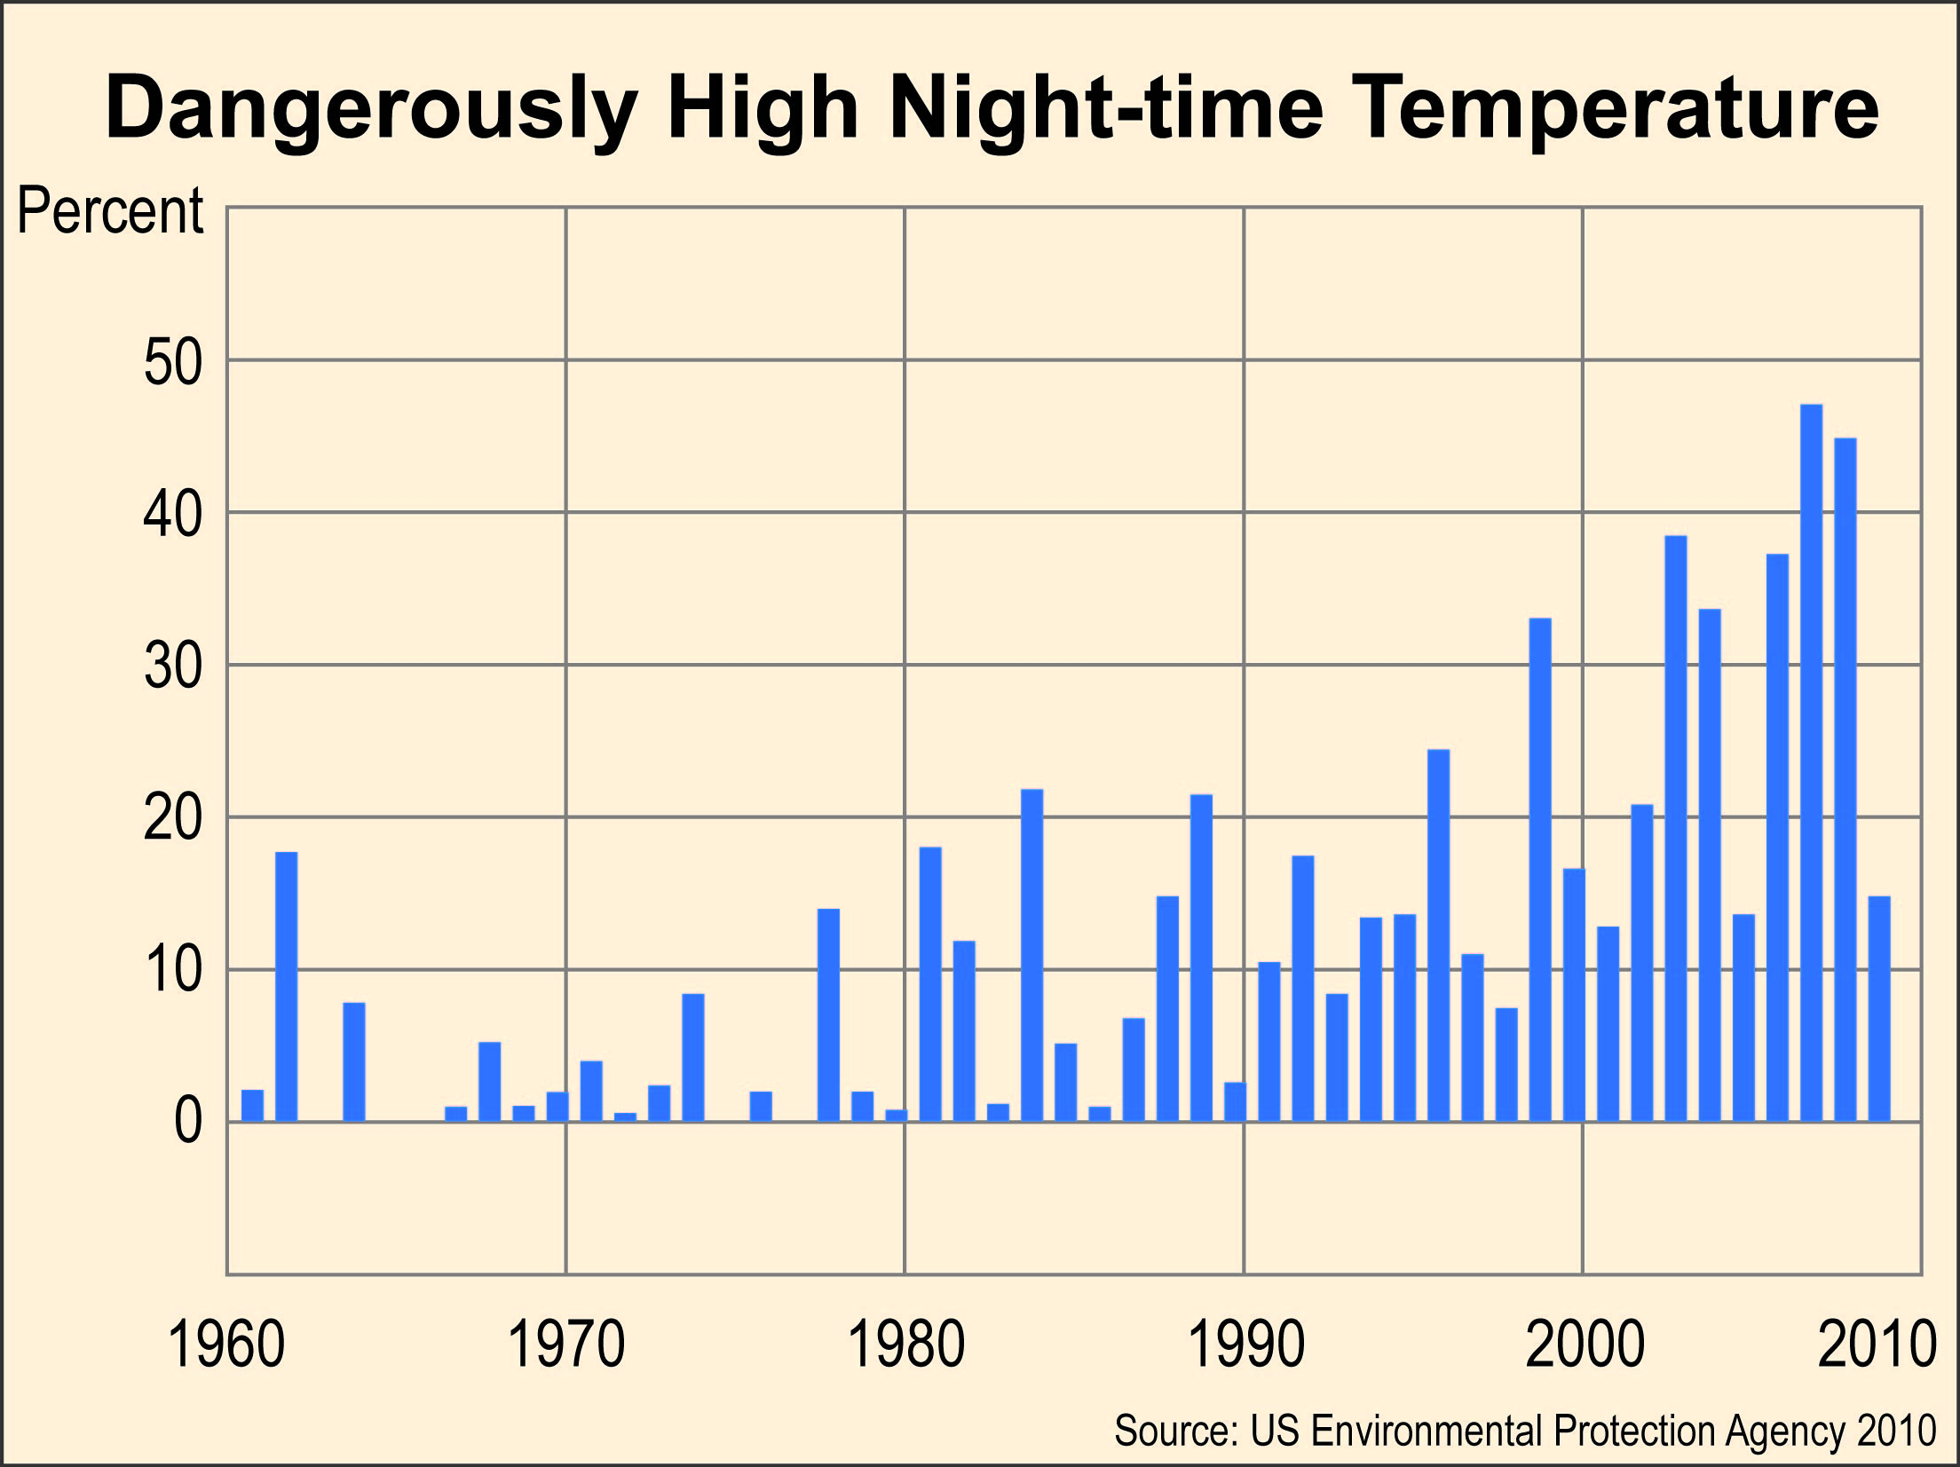

Slide 15
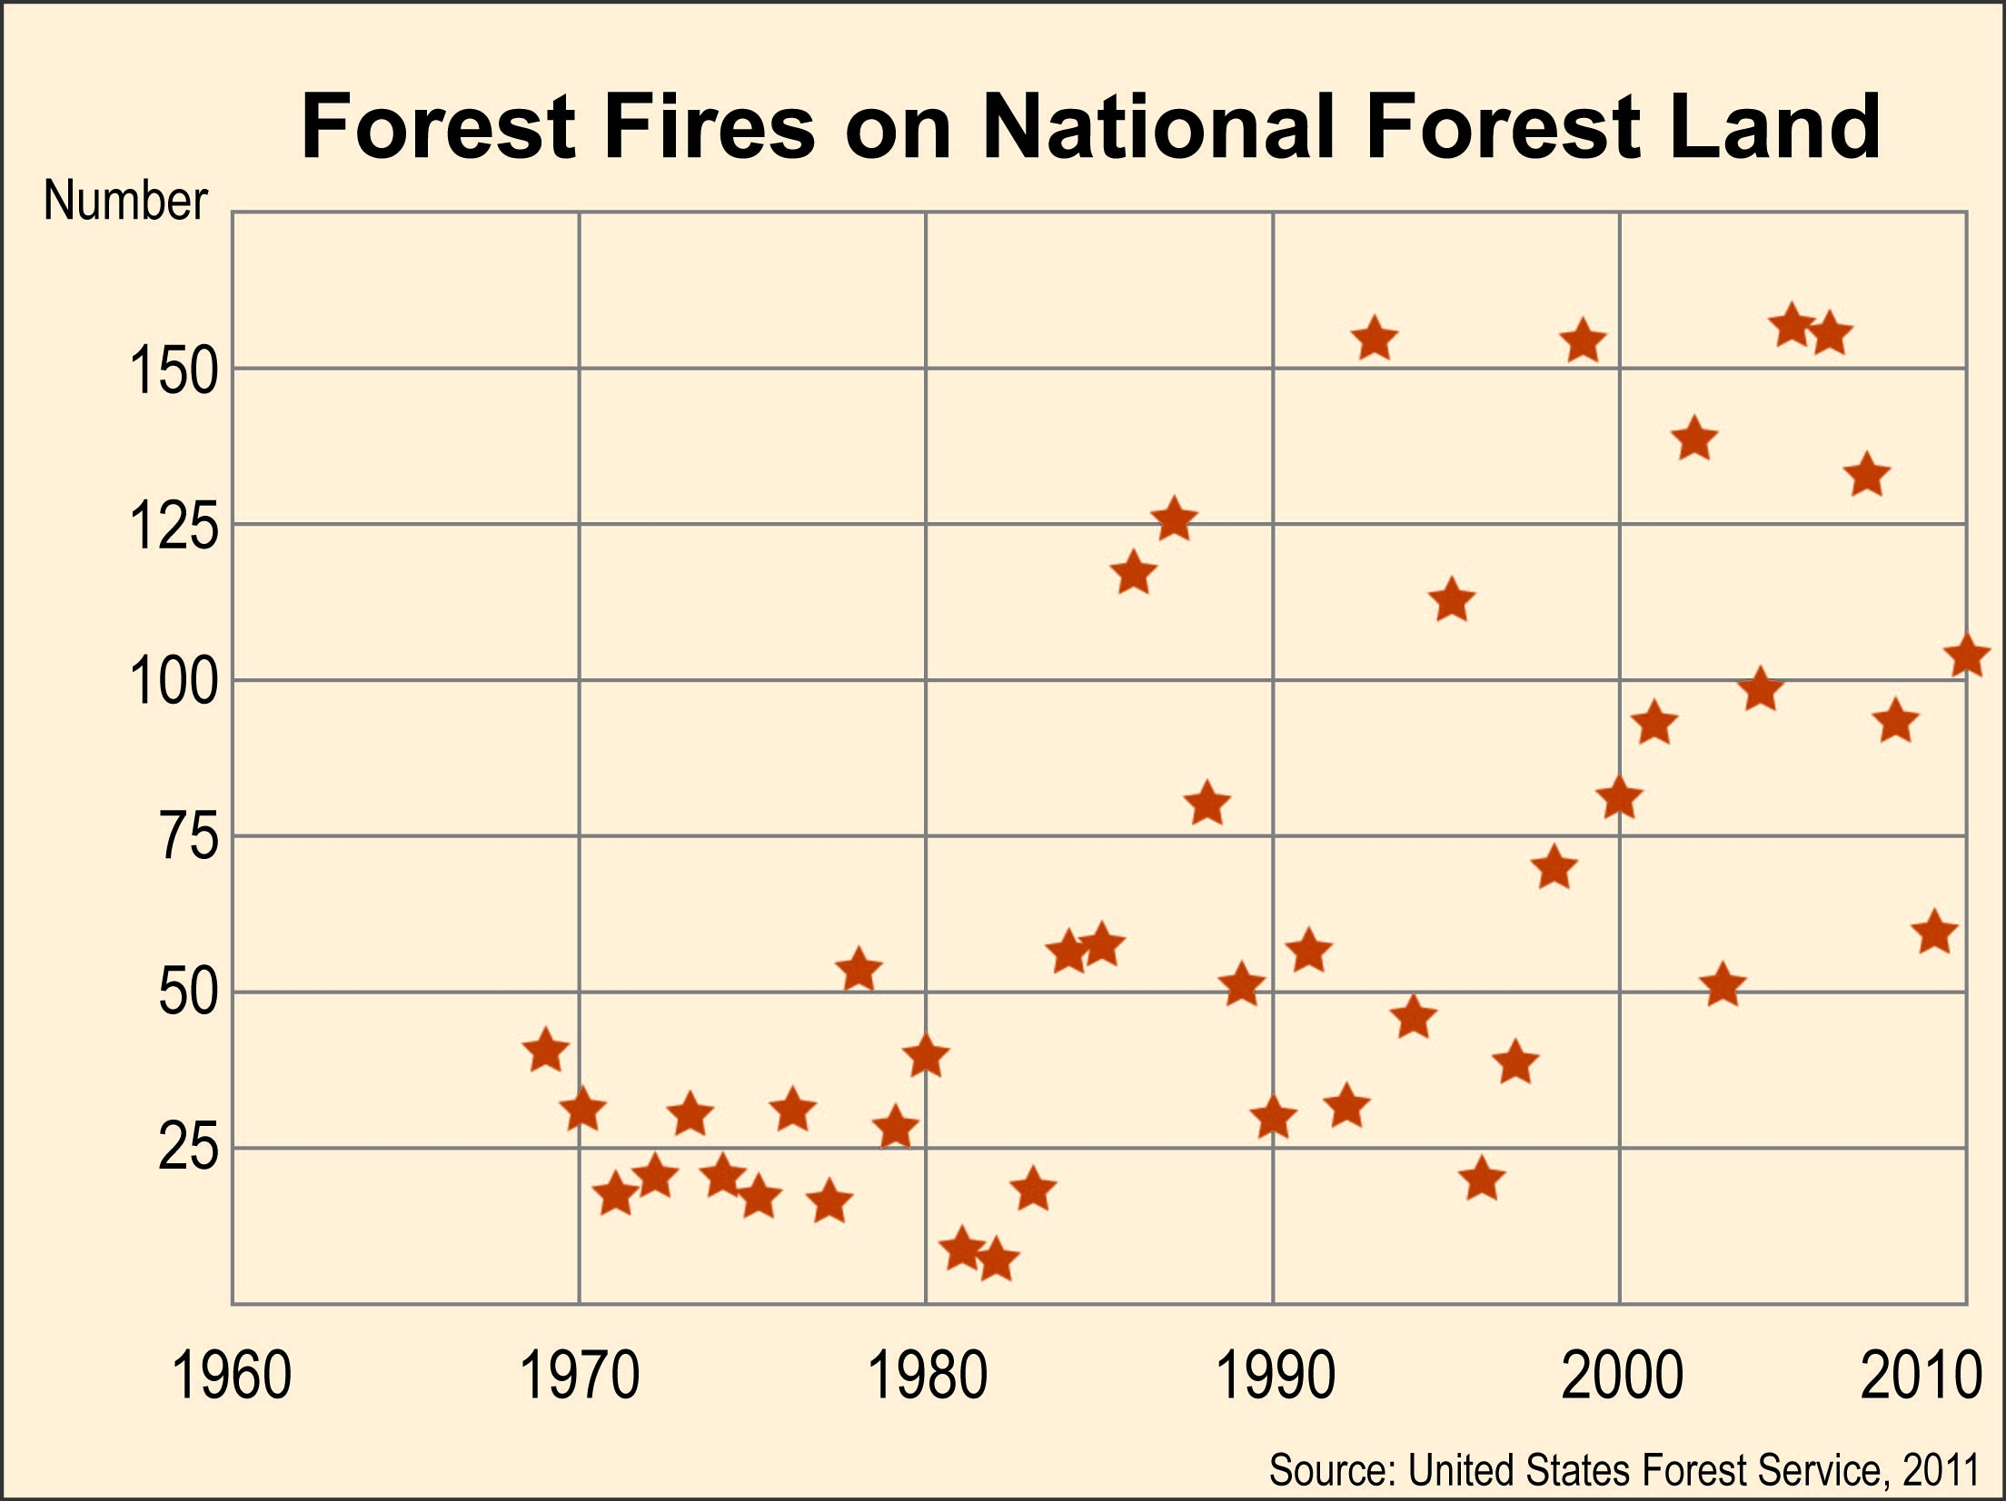

Slide 16
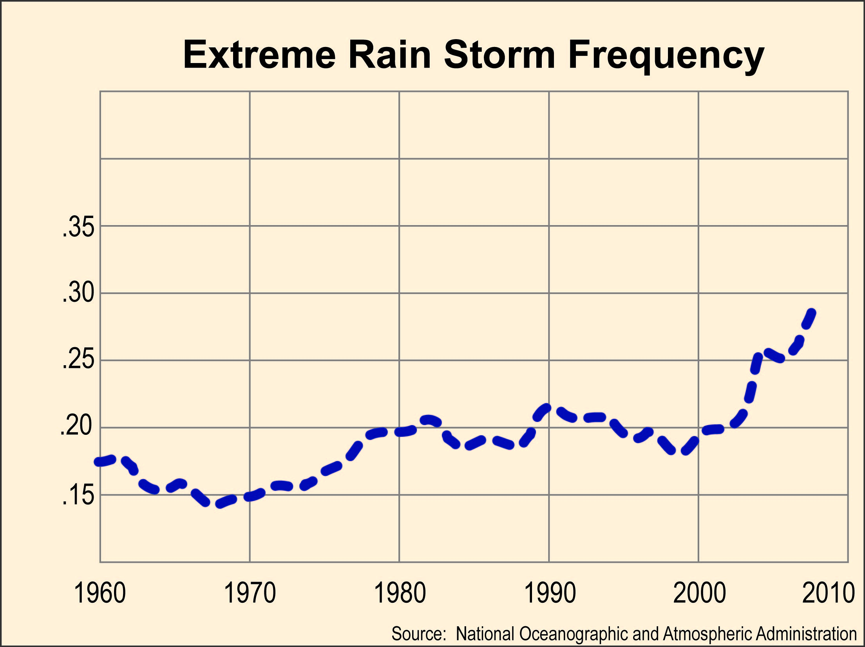

Slide 17
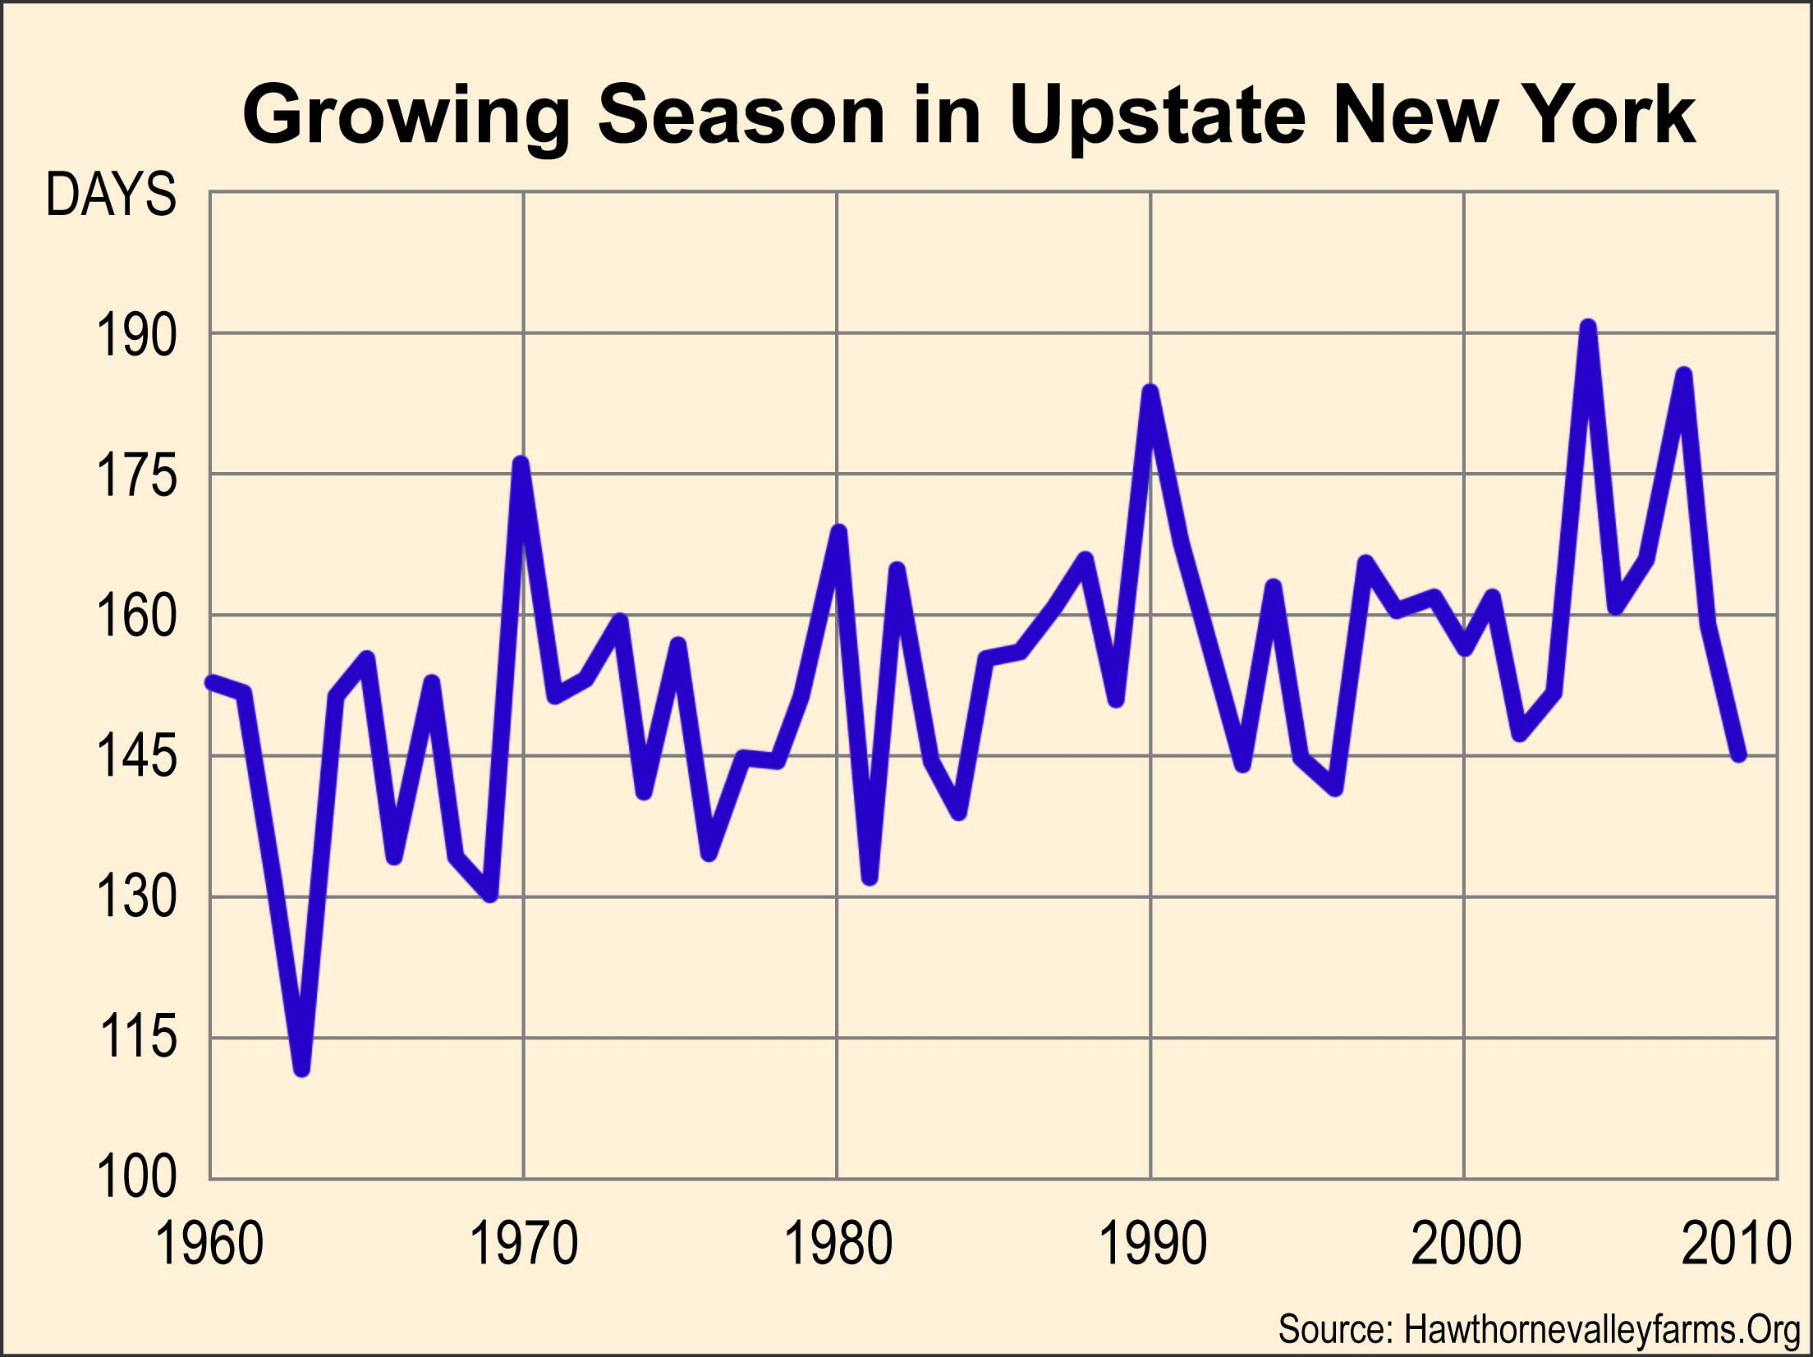

Slide 18
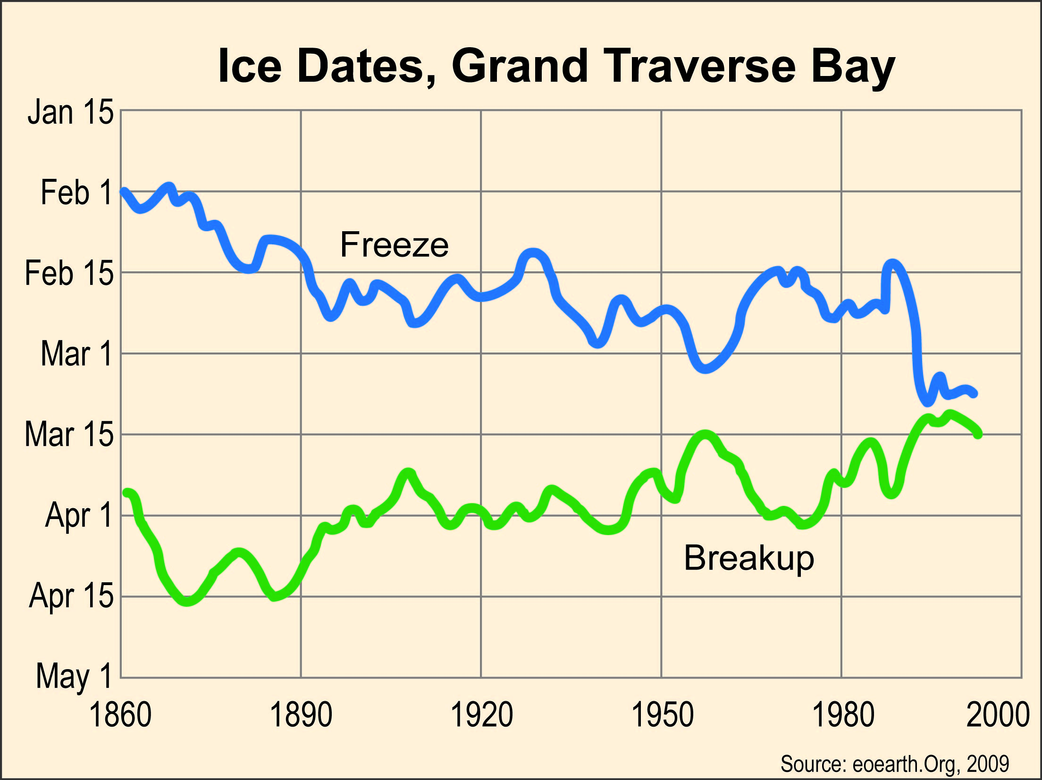

Slide 19
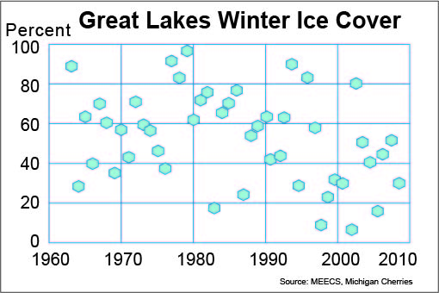

Slide 20
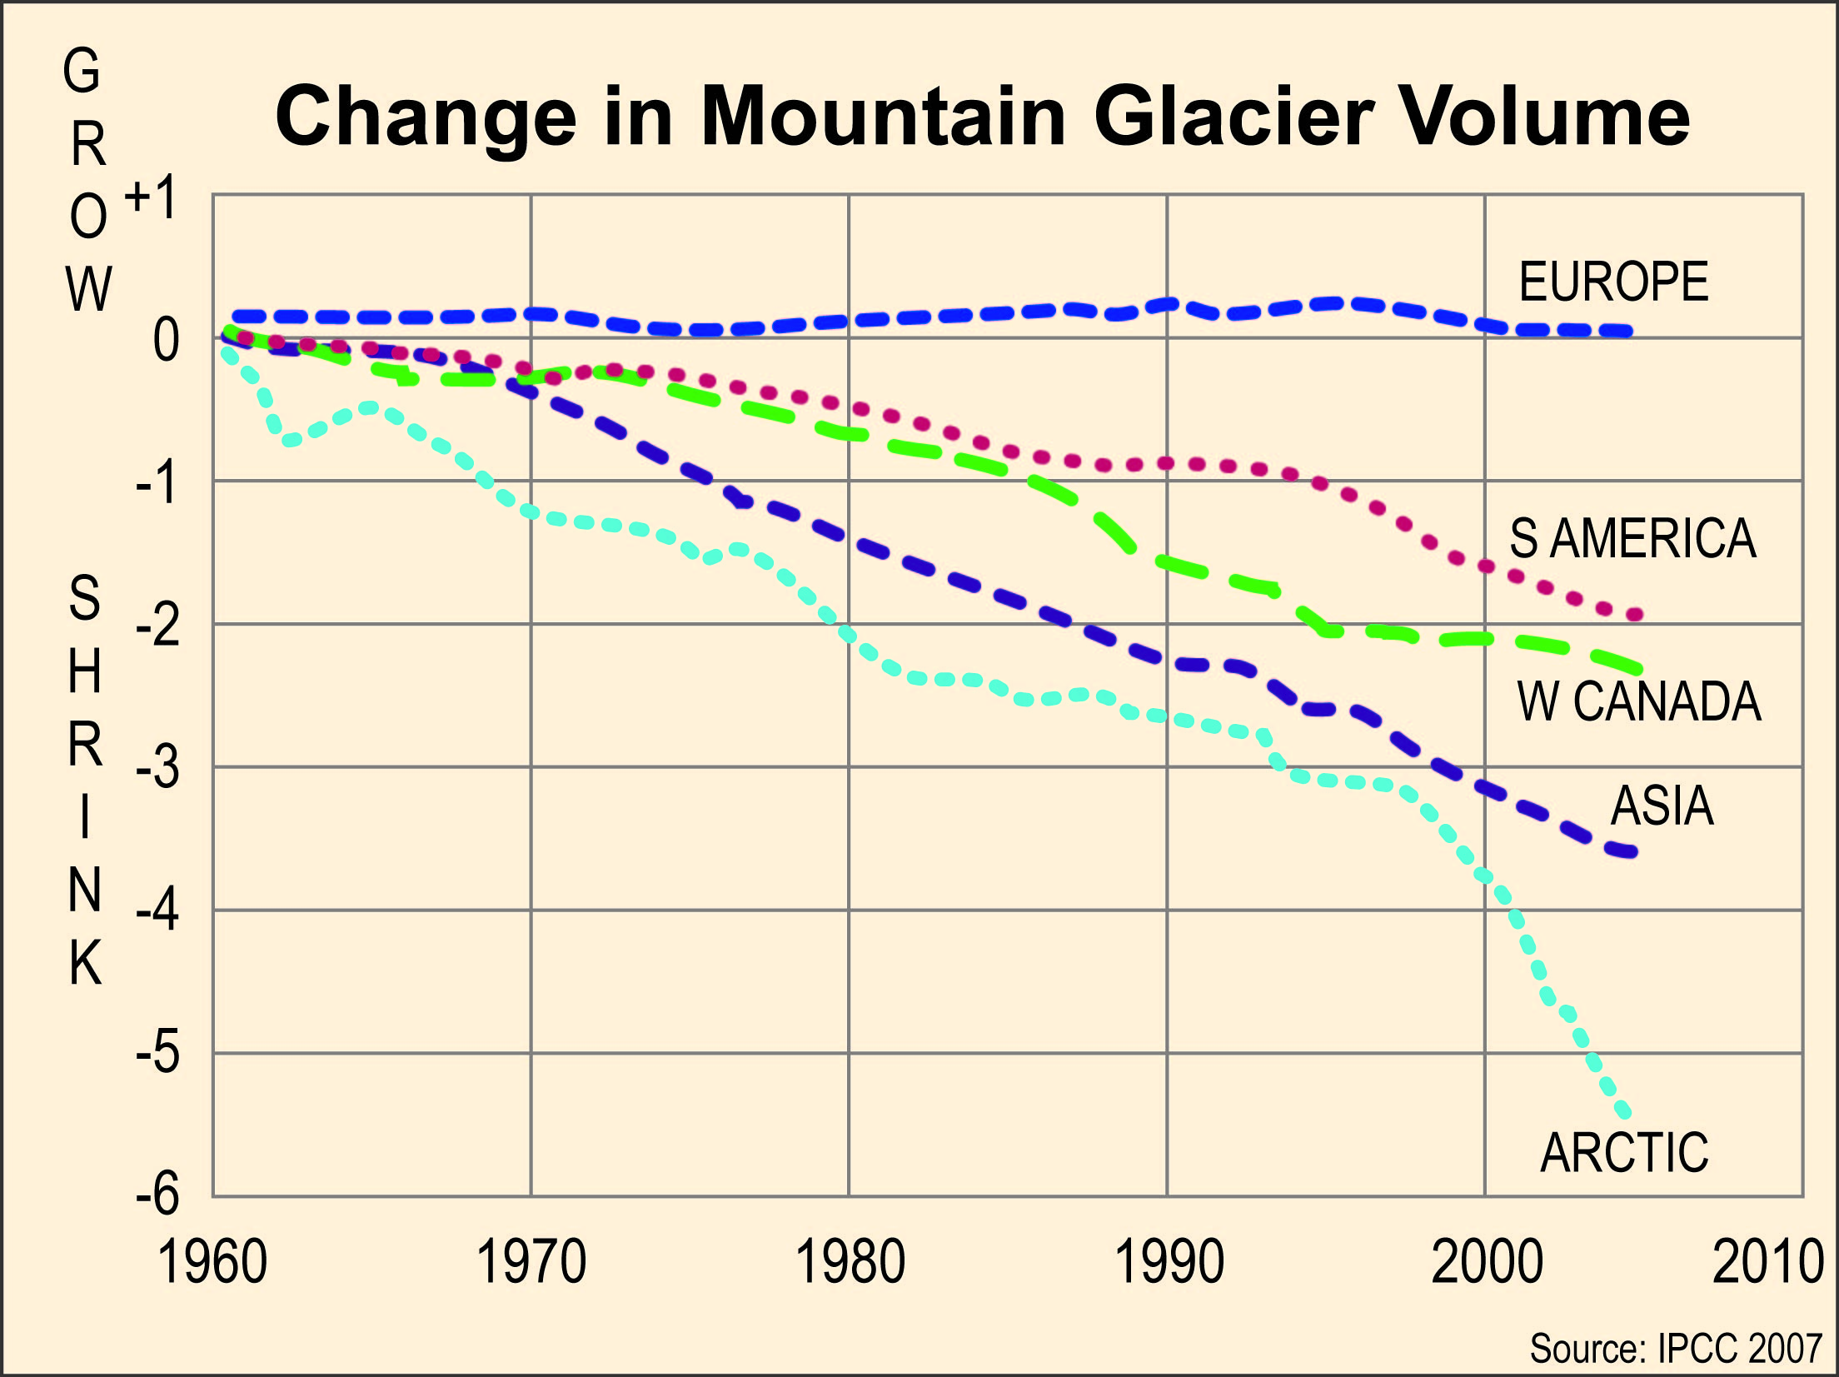

Slide 21
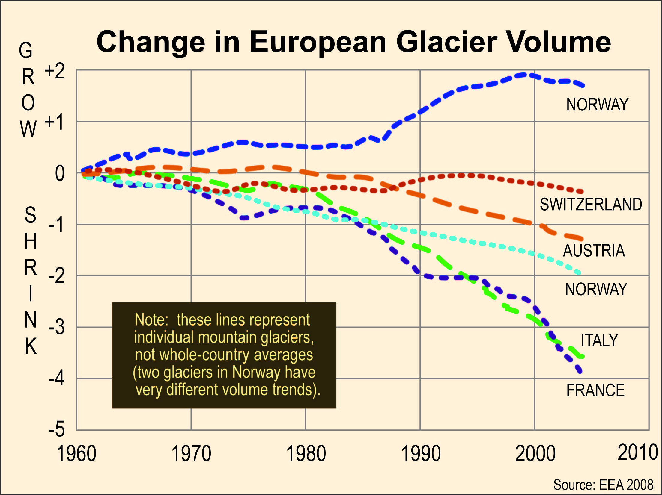

Slide 22
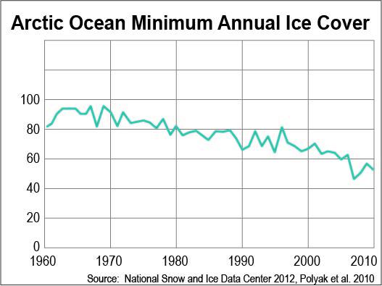

Slide 23
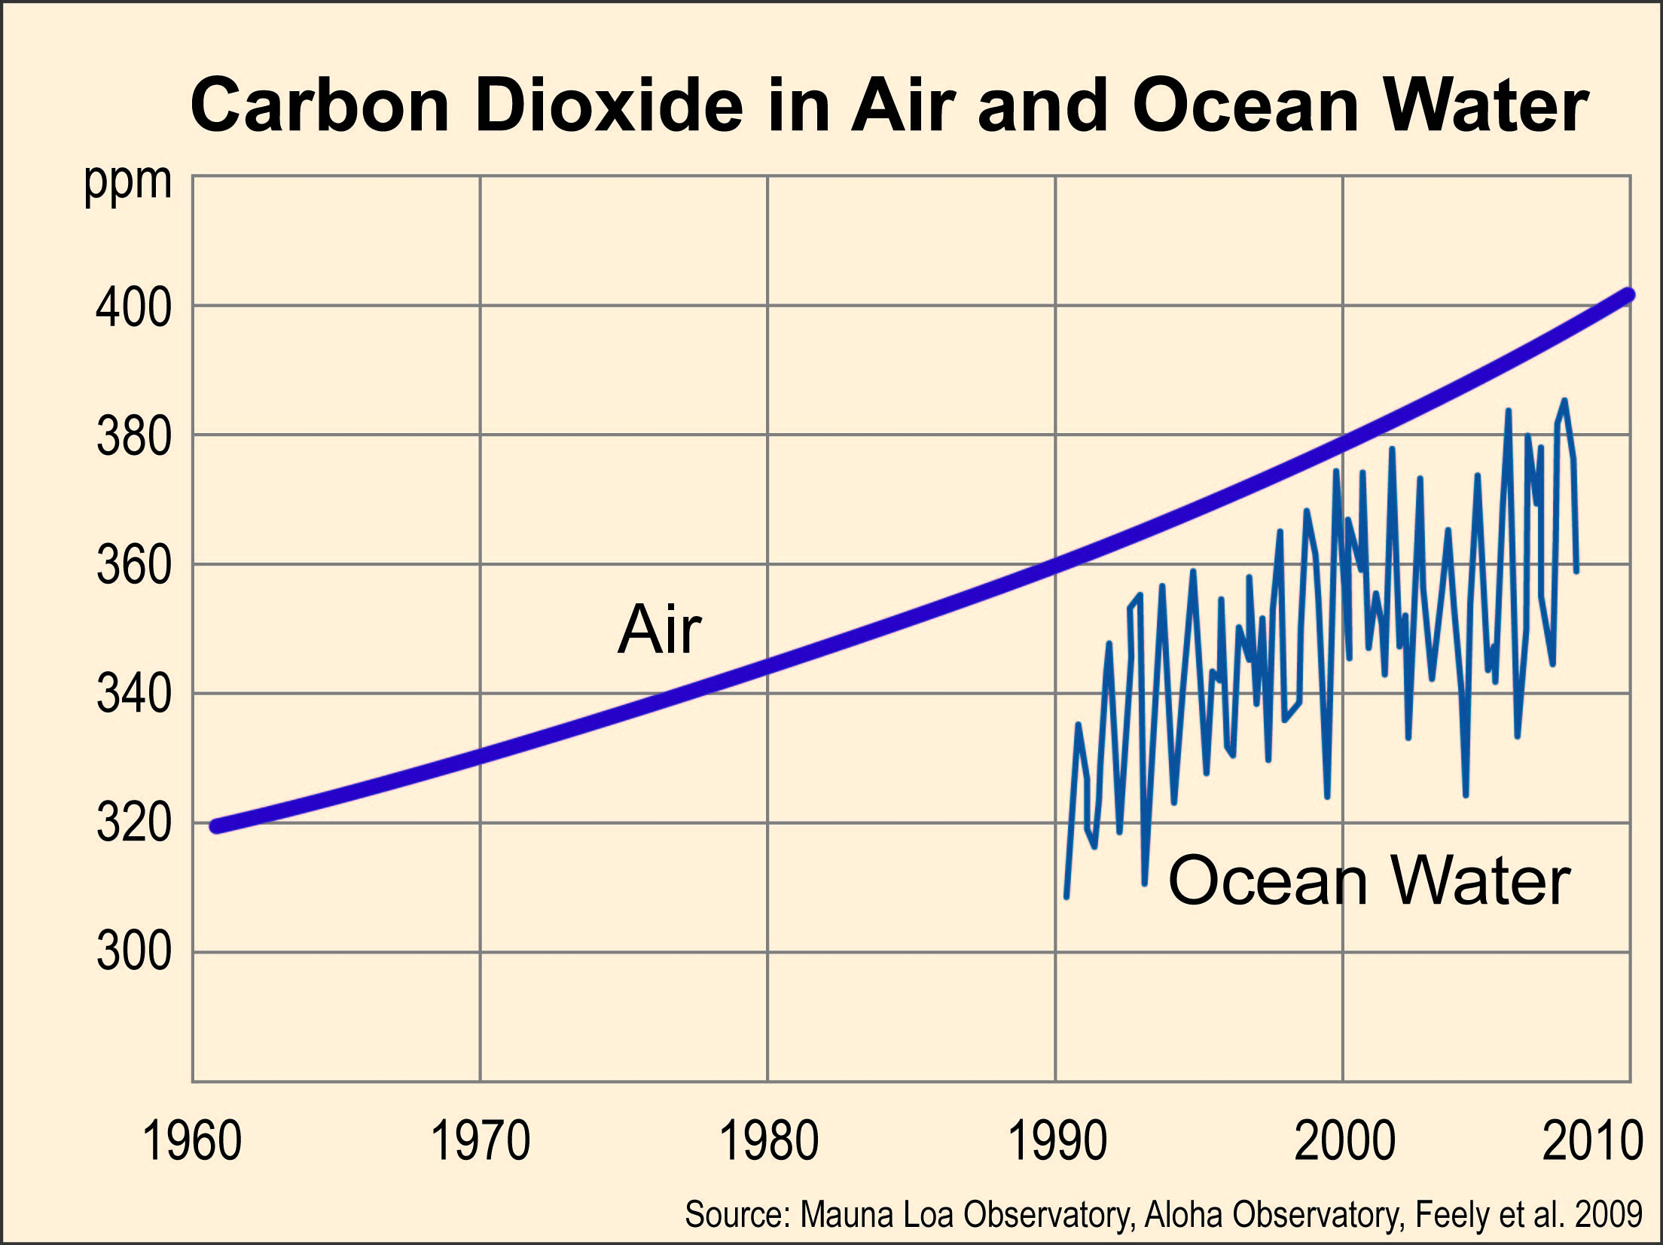

Slide 24
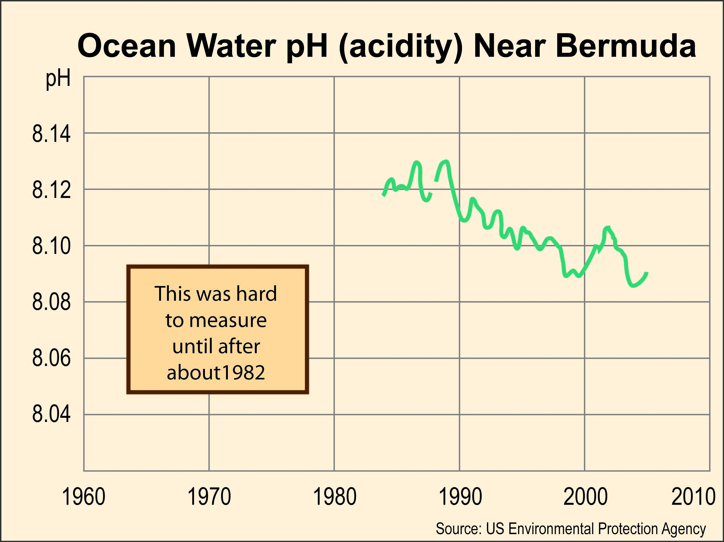

Slide 25
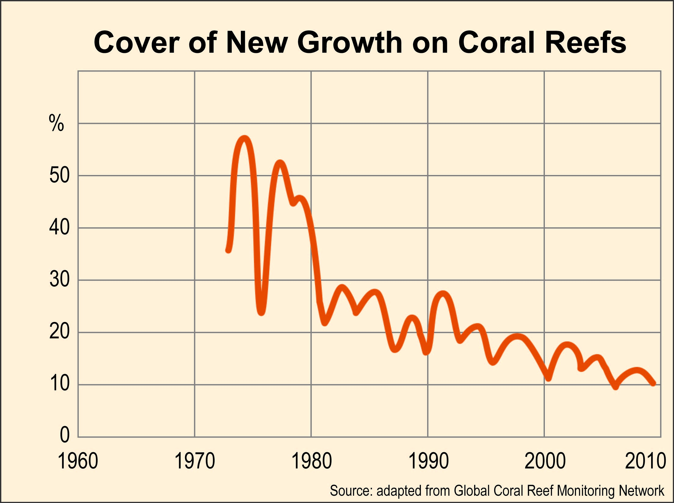

Slide 26
Climate Change
in the Great Lakes
Dr. Don Scavia
Great Lakes Integrated Science and Assessments

Slide 27
How has the global and regional climate changed?
Part 1 (0:00 to 7:51)
What are the three aspects of temperature and precipitation that scientists study?
What do records show about temperature and precipitation?
Summary of existing trends

Slide 28
What are the projected
global and regional changes?
Part 2 (7:51 to 16.20)
What is the projected temperature change?
How will precipitation change?
Summary of Global and Regional Changes

Slide 29
What are the expected
regional impacts?
Part 3 (16.20 to 30:55)
What did the video say about the number of days of snow in Michigan?
What about water levels of the Great Lakes?
What are some of the impacts Dr. Scavia mentioned?

Slide 30
Questions to consider:
What might be some consequences of fewer days of snow in Michigan?
What are some consequences of either a rise in lake levels or a drop in lake levels?
What do you think Dr. Scavia meant when he said:
“We have to double down our efforts to try to delay and decrease the amount of climate change in the future, but at the same time we need to prepare for that inevitable change that we are going to be seeing.”

Slide 31
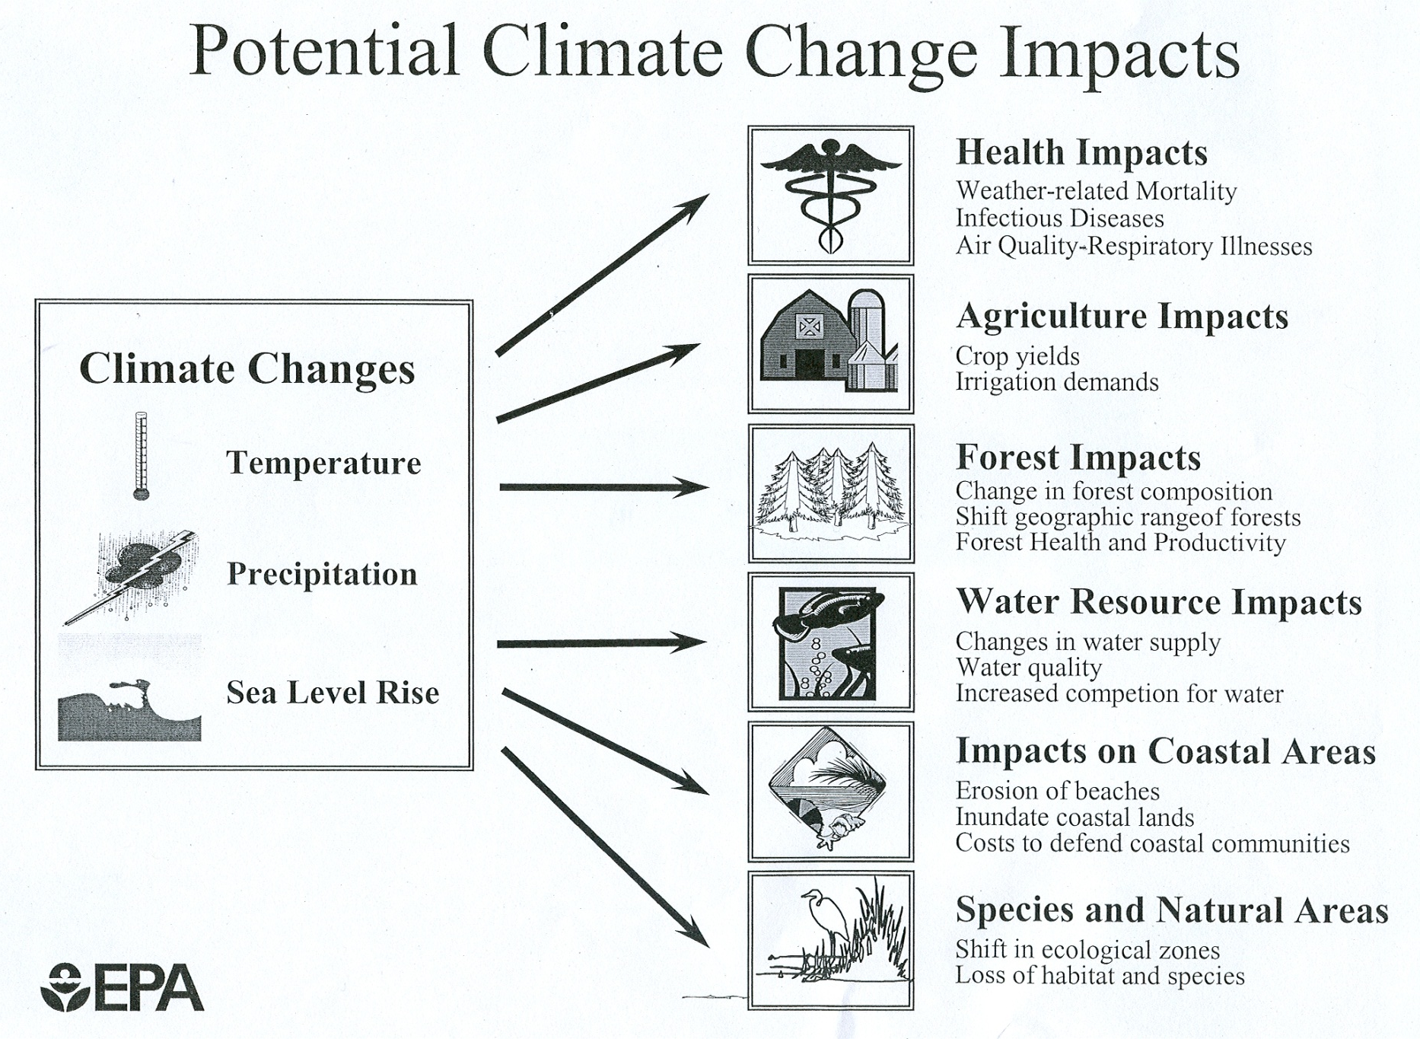
Change in forest composition
Shift geographic range of forests
Forest Health and Productivity
Changes in water supply
Water Quality
Increased competition for water

