Slide 1
Ecosystem Relationships

Slide 2
Ecosystem Relationships
Geographic Range:
the group of places that meets the environmental preferences
for a species
Ideal?
Conditions -
Acceptable?
Intolerable?

Slide 3
Ecosystem Relationships
Ecological Habitat:
summary of acceptable environmental conditions
disease
wind speed
temperature
moisture
insects
slope
soil quality

Slide 4
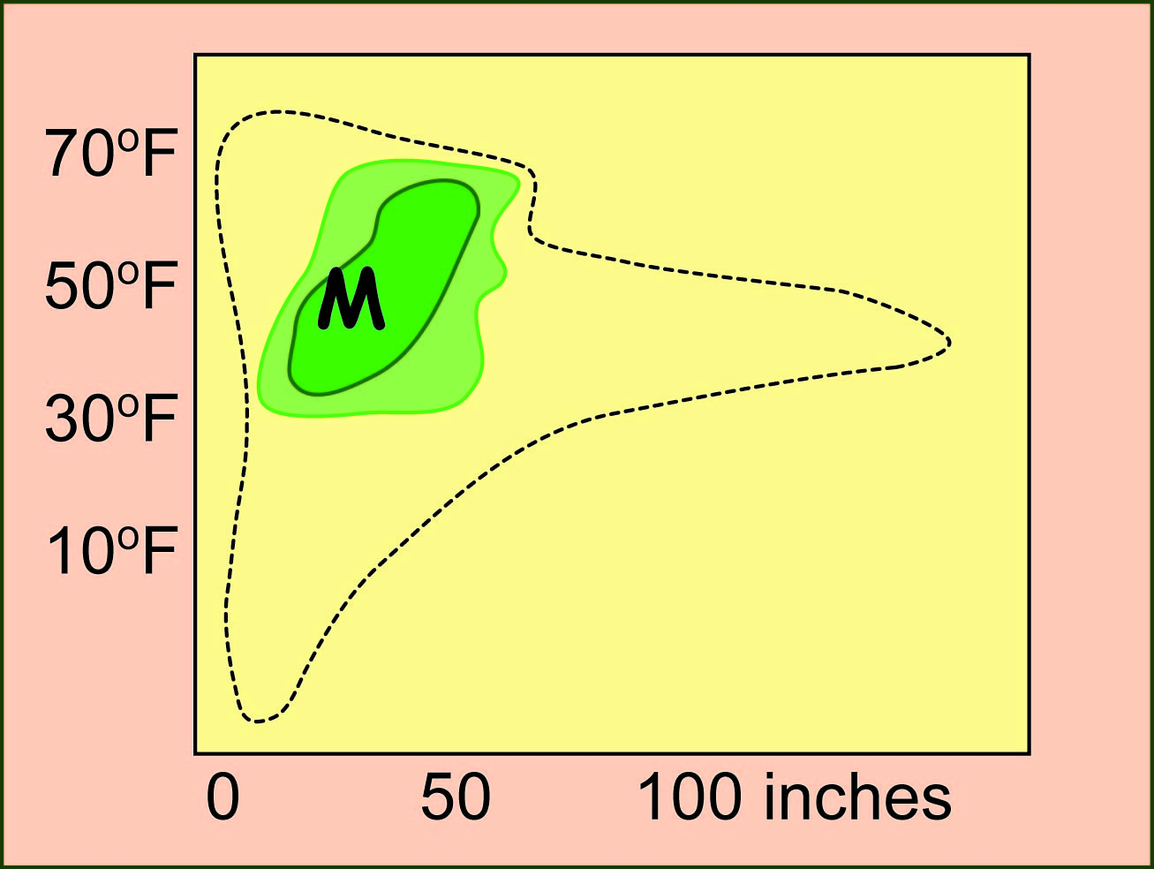
Ecosystem Relationships
Temperature Range
Precipitation Range

Slide 5
Ecosystem Relationships
30-50 in.
of rain
35° - 65°
15-30 in.
of rain
American Elm

Slide 6
Ecosystem Relationships

Slide 7
Ecosystem Relationships

Slide 8
Ecosystem Relationships
Black Spruce
White Pine
Slash Pine
Cottonwood
Red Oak
Paper Birch
Which of these trees might increase if climate change makes Michigan warmer and drier?
Which ones might decrease?

Slide 9
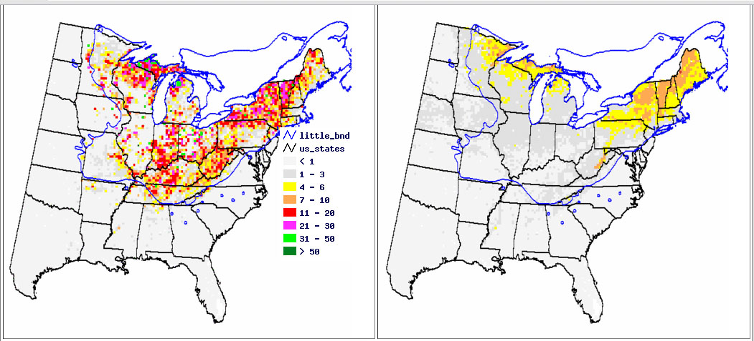
Ecosystem Relationships
Sugar Maple
Present Range
Predicted Range 2100

Slide 10
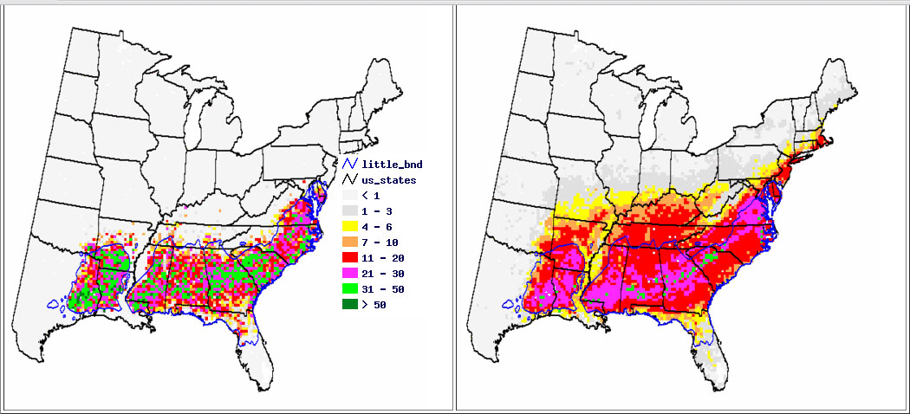
Ecosystem Relationships
Loblolly Pine
Present Range
Predicted Range 2100

Slide 11
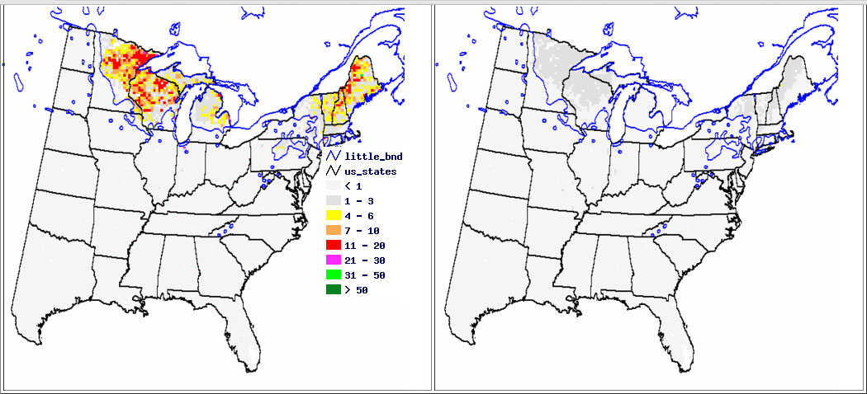
Ecosystem Relationships
Paper Birch
Present Range
Predicted Range 2100

Slide 12
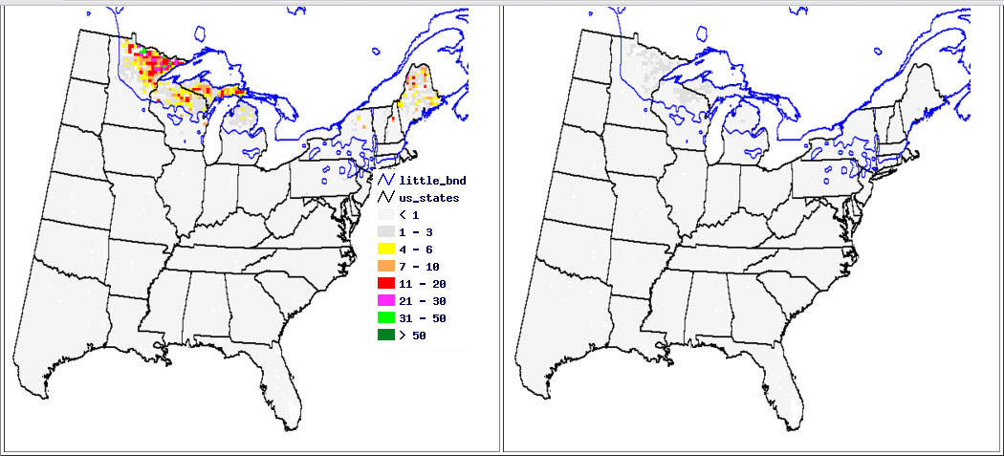
Ecosystem Relationships
Black Spruce
Present Range
Predicted Range 2100

Slide 13
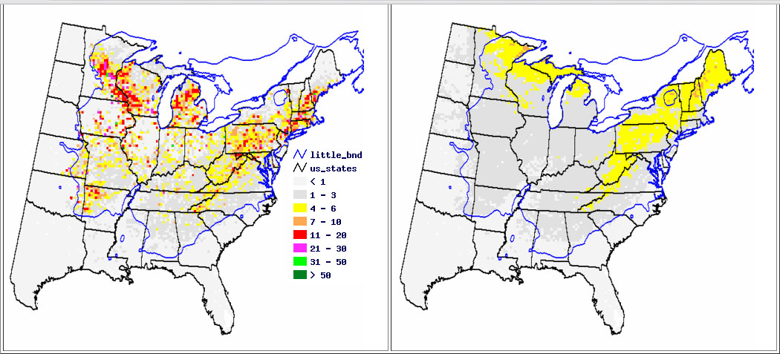
Ecosystem Relationships
Red Oak
Present Range
Predicted Range 2100

Slide 14
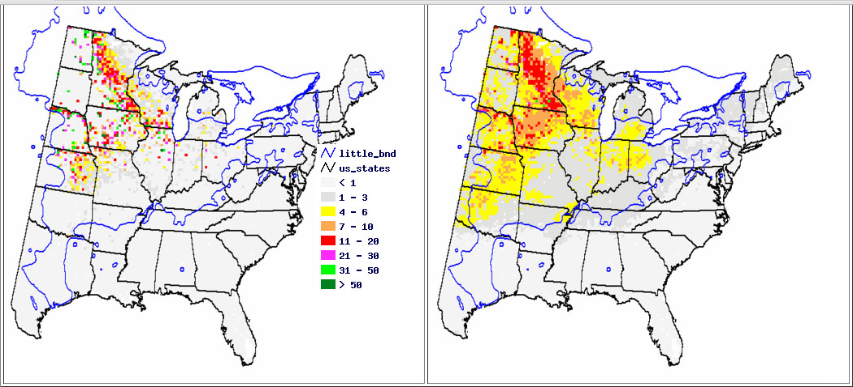
Ecosystem Relationships
Bur Oak
Present Range
Predicted Range 2100

Slide 15
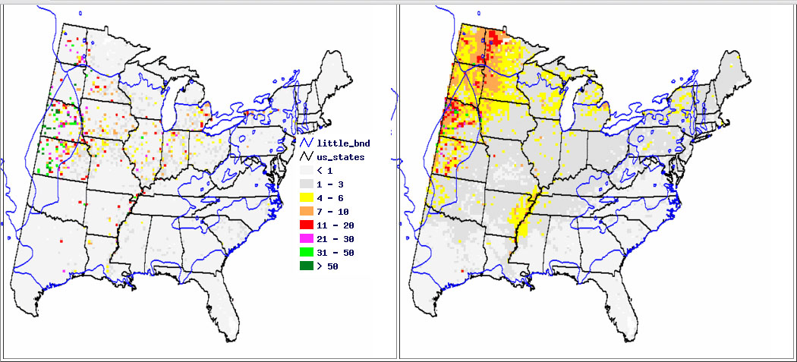
Ecosystem Relationships
Cottonwood
Present Range
Predicted Range 2100

