Slide 1
Water Balance and the Great Lakes

Slide 2
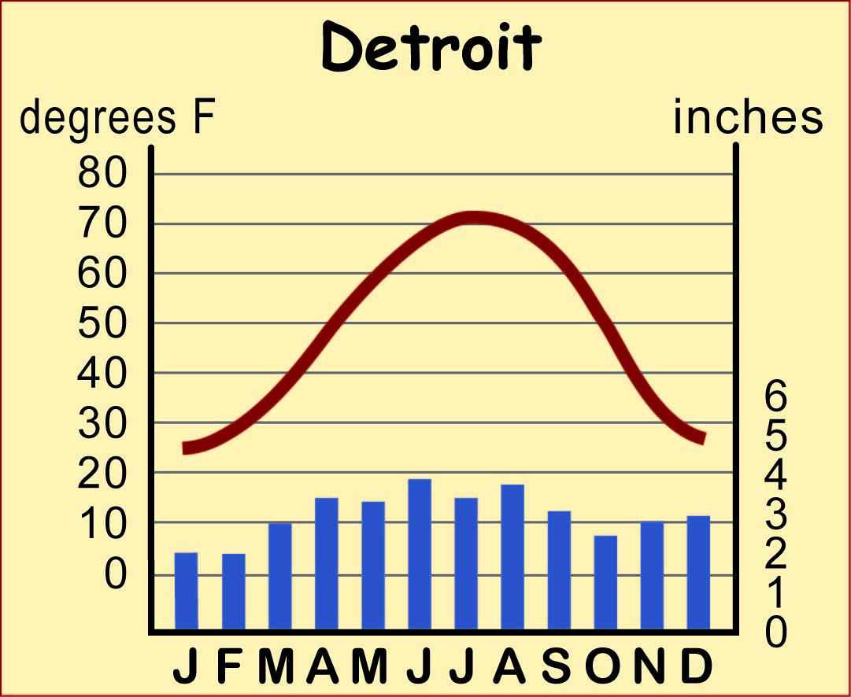
Climagraph of Detroit

Slide 3
A Climagraph of Detroit
Which month has the most precipitation?
June
How much?
Almost 4”
What is the lowest average monthly temperature experienced by Detroiters in 2010?
25⁰

Slide 4
A Climagraph of Detroit
How many inches of rain does Detroit get in a typical September?
3”
What is the average temperature in Detroit in May?
60⁰
In July?
70⁰

Slide 5
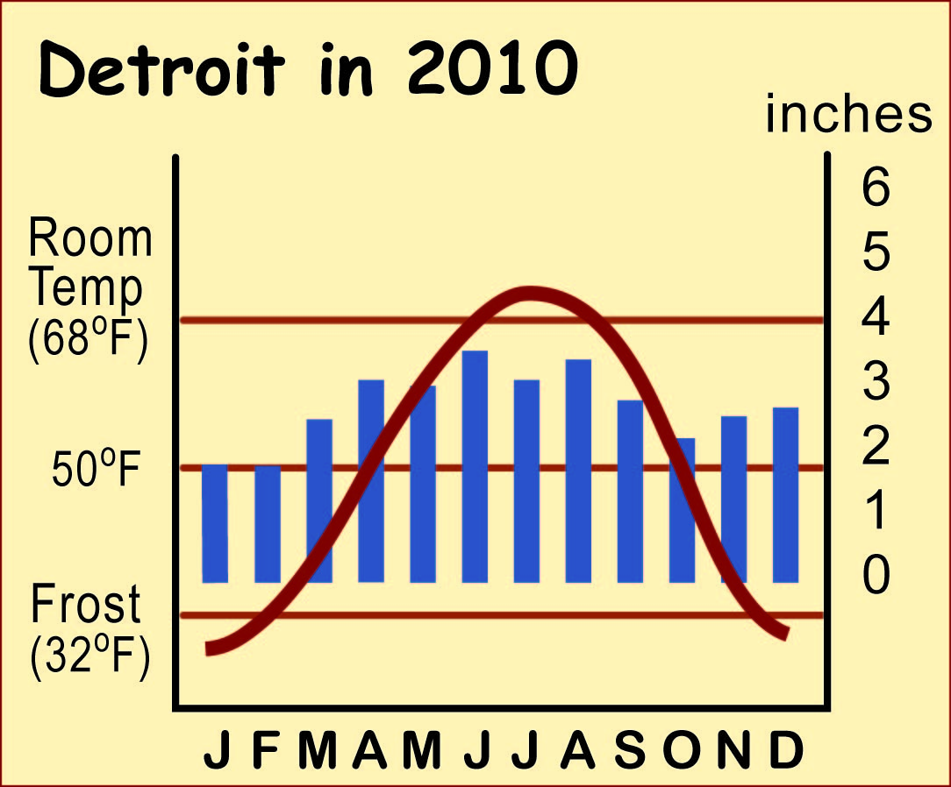
Climagraph of Detroit, Redesigned

Slide 6
A Climagraph with a Better Design
How many months have average temperatures clearly above room temperature?
2
How many months have average temperatures clearly above 50 degrees Fahrenheit?
5

Slide 7
Climagraph of Detroit, Redesigned

Slide 8
A Climagraph with a Better Design
If the precipitation bar
for a month extends
above the temperature line there is a
moisture
surplus

Slide 9
A Climagraph with a Better Design
If the precipitation bar
for a month does not reach the temperature line
there is a
water deficit

Slide 10
A Climagraph with a Better Design
How many months have a water surplus in Detroit?
6
How many months normally have a water deficit in Detroit?
4
What is the water deficit in August?
1 inch

Slide 11
How Climate Change Can Alter the Water Balance
In 2010 Detroit had…
*2 months when air-conditioners were useful
*2 months when the ground was frozen solid
*about 5 months of growing season.

Slide 12
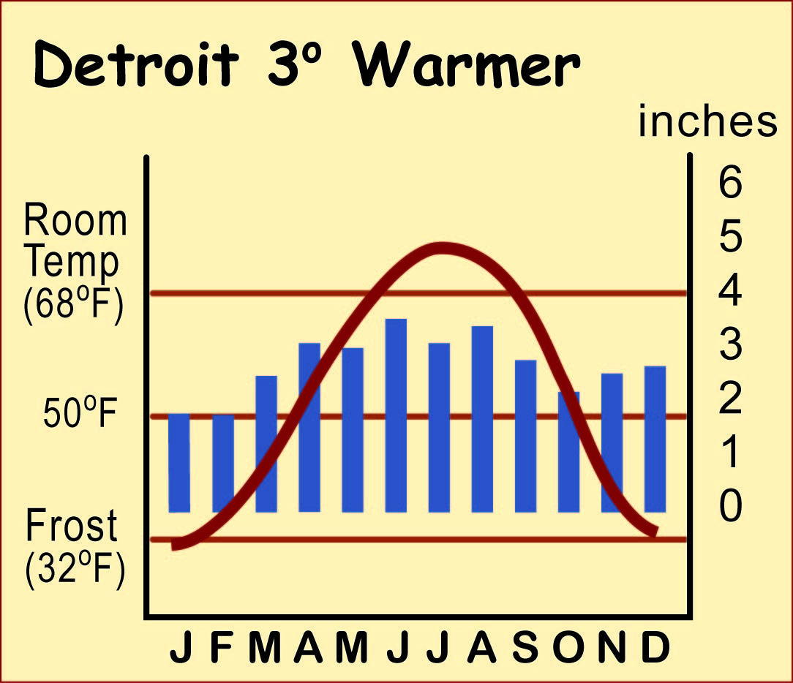
How Climate Change Can Alter the Water Balance
If the temperature
rises 3⁰.....
How many months need air-conditioning?
3
How many months have a water deficit?
4
What is the likely water deficit after climate change?
Higher - Up to about 5 inches

Slide 13
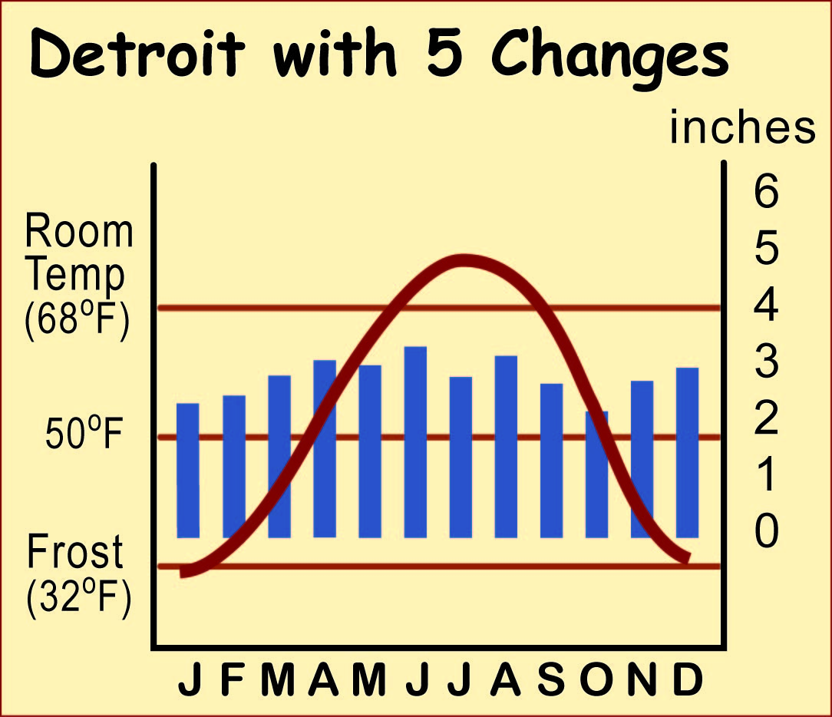
How Climate Change Can Alter the Water Balance
Five likely changes:
Temperatures will go up
Precipitation in winter will go up
Winters will have more rain and less snow
Summer storms may get stronger , with more rain in a short time, but
Total rainfall in summer will go down, because there will be fewer storms.
What happened to the water balance?

Slide 14
Water levels in the Great Lakes

Slide 15
Water levels in the Great Lakes
The level of water in a lake depends on the balance between four things:
How much rain and snow fall
directly into the lake
How much water evaporates
from the surface of the lake
How much water comes into the lake
from rivers and groundwater springs
How much water goes out of the lake
in rivers or groundwater seepage

Slide 16
Water levels in the Great Lakes
Effects of Climate Change
on the Great Lakes
Cause
Higher water temperature
Stronger summer storms
Shallower water
Effect
More plants growing near shore
Less ice cover in winter
Possible damage to docks

Slide 17
Water levels in the Great Lakes
Effects of Climate Change
on the Great Lakes
Cause
Higher water temperature
Less total rain in summer
Lower average water levels
Stronger winds during storms
Effect
less oxygen in lake water for fish
more lake-effect snow in winter
less ice cover on lakes in winter
last spring frost on nearby land is earlier
? ? ? ? ? ? ? ? ? ? ? ? ? ? ? ?
? ? ? ? ? ? ? ? ? ? ? ? ? ? ? ?
? ? ? ? ? ? ? ? ? ? ? ? ? ? ? ? ? ? ?
Describing Cause and Effect is complicated.
Can you explain these?

